Slide 1
Financial tracker using AI
Trackify
Presented by Ovidiu, Andrei, Mihai, Vio, Dinu

Slide 2
CONTENT OF THE PRESENTATION
The purpose of Trackify demo The thought behind it The usage of Gemini

Slide 3


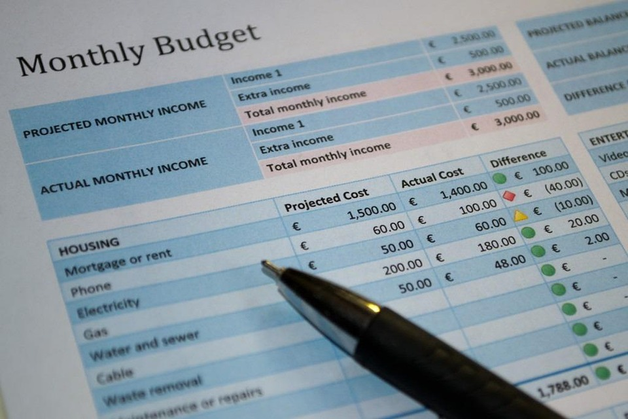

The purpose of Trackify
Managing expenses can be overwhelming in today’s fast-paced world. From unexpected bills to daily spending, keeping track of finances feels like a full-time job.
We wanted to create a functional and easy-to-use app for people to organize their history regarding receipts and have a simple way to check the history of expenses.

Slide 4
The thought behind it
The idea behind Trackify was born from a simple thought: What if managing your money could feel as effortless as spending it?
Our goal is to empower everyone to take control of their finances with ease, clarity, and confidence.

Slide 5

Usage of Gemini
Implementaion
Processing
We implemented Trackify in collaboration with Gemini, utilizing their cutting-edge technology to create a seamless and user-friendly app.
Gemini's advanced image processing technology powers Trackify to provide users with seamless receipt scanning and automatic expense count.

Slide 6
Thank you for your attention!
_.ovidiuu cl16andrei
alexa.violeta catalin.banica14
_dinu.m

